Slide 1

Capstone Project

Slide 2



Personal BACKGROUND
(Name, Past Experience, Qualification, Career Summary)
Name : Bashaboina Raju
Past Experience : Skilled in Azure Cloud, Azure DevOps, Java, SQL, Linux, and GitHub.
Qualification : Bachelor Of Engineering (B.E) in Electrical and Electronics Engineering
Career Summary : I am a fresher Gained hands-on experience in end-to-end automation using Selenium for web UI, Postman/Newman for API testing, JMeter for performance testing, Jenkins for CI/CD, and Jira for test and sprint management, enabling effective design, execution, and management of real-time test scenarios with industry-standard tools.
www.collaberadigital.com

Slide 3


Key Takeaways/Learnings from the Program (HTD)
Comprehensive Testing Expertise – Acquired practical experience in manual, automation, functional, and non-functional testing across various stages of the software development lifecycle.
Agile Methodology in Action – Effectively implemented Agile and Scrum practices using tools like Jira to manage and track the complete testing lifecycle.
Automation Framework Development – Designed and implemented robust automation frameworks using Selenium with Java and Python, incorporating Maven, Page Object Model (POM), log generation, reporting, and executed test scripts using JUnit, TestNG, and PyTest.
API and Mobile Testing Experience – Gained hands-on experience in API testing with Postman and Newman, along with mobile automation using Appium.
CI/CD and DevOps Integration – Familiar with version control and continuous integration processes using tools such as Git and Jenkins.
Performance Testing Proficiency – Acquired working knowledge of JMeter, including CRUD operations, samplers, listeners, configuration elements, and report generation.

Slide 4

Problem Statement of the Capstone Project
The goal of this Capstone Project is to develop a comprehensive test automation suite for web UI, API, and performance testing using Selenium (Java, TestNG, POM), Postman/Newman, and JMeter, with GitHub integration and CI practices to ensure robust, reusable, and maintainable tests with effective execution and reporting.

Slide 5
Selenium Web UI Test Automation (Java + TestNG)
Designed a robust automation framework using the Page Object Model (POM) for maintainability, automating key functional test cases such as Login, Register a new user , and Add two products to cart and verify cart.
Integrated Log4j for detailed logging and implemented screenshot capture on failures for effective debugging.
Application Url: https://automationexercise.com

Slide 6
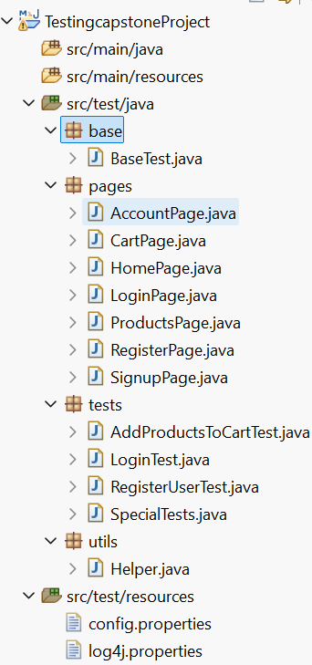
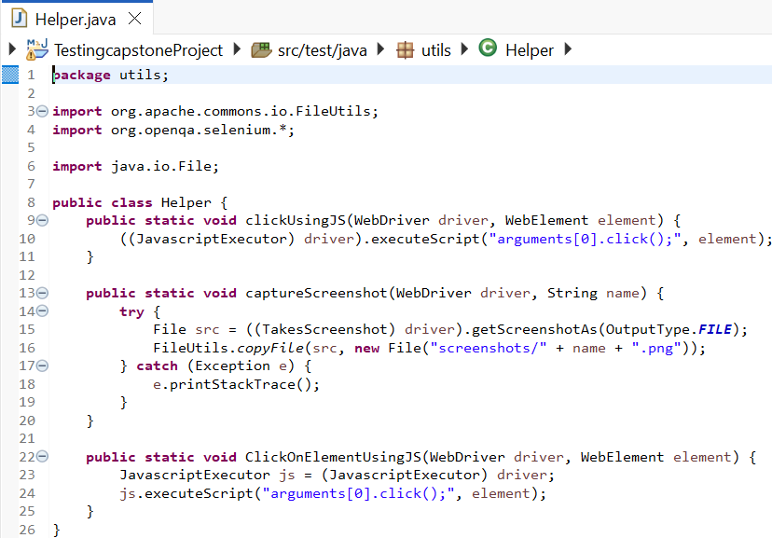
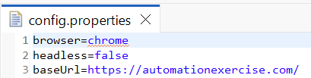
Selenium java Structure

Slide 7
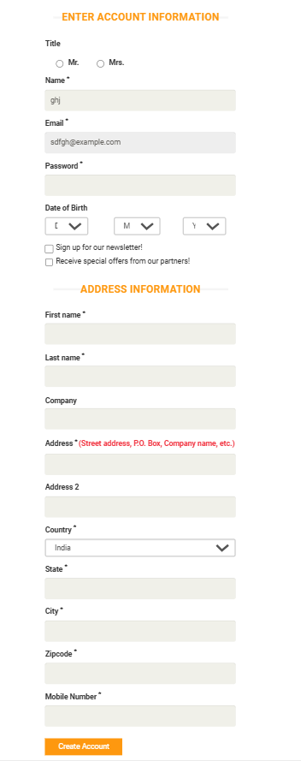
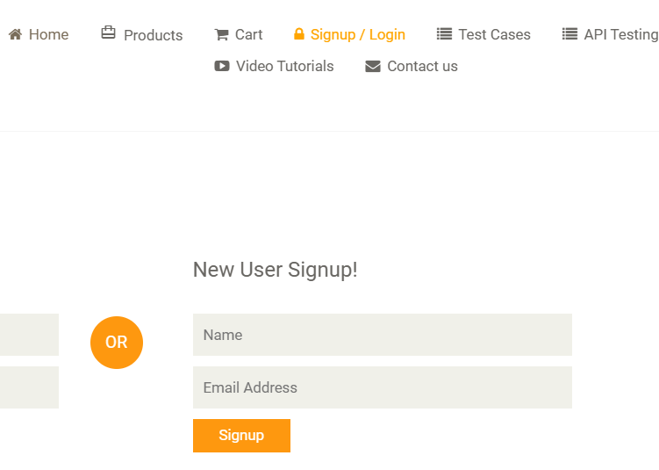
Scenario 1: Register a new user with valid details
1. RegisterUserTest.java
Pre-condition:
The user is on the Home page of “https://automationexercise.com”.
A unique and valid email address is available.
Acceptance Criteria:
User should be able to navigate to the Signup/Login page.
User must fill all required fields correctly.
The system must validate the form and process the registration.
A confirmation of account creation must be shown.
Expected Result:
The account is created successfully.

Slide 8
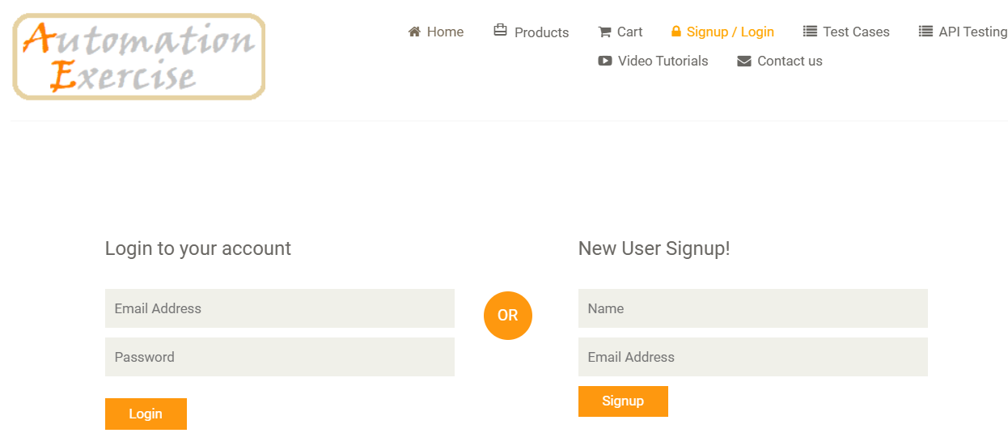
Scenario 2: Login with valid credentials
2. LoginTest.java
Pre-condition:
The user is on the Home page.
A registered user account with valid credentials exists.
The user is currently logged out.
Acceptance Criteria:
Login form is displayed with email and password fields.
User enters correct credentials.
System validates credentials and logs the user in.
Expected Result:
User is successfully logged in.
Redirected to account dashboard.
Username appears in the header.

Slide 9

Scenario 3: Add two products to cart and verify cart
3. AddProductsToCartTest.java
Pre-condition:
User is on the Products page.
Website is accessible.
At one products are available on the page.
Acceptance Criteria:
User can hover over a product and click “Add to cart.”
Clicking “View Cart” shows both products.
Cart shows correct product details: name, price, quantity, and total.
Expected Result:
selected products are successfully added to the cart.
Cart displays correct prices, quantities, and total amount.

Slide 10
API Automation with Postman and Newman
API Testing: Design Postman collections to test APIs using methods like GET, POST, PUT, PATCH, and DELETE.
Assertions: Validate response status codes, body content, headers, and response times.
Automation: Export Postman collections and run them using Newman CLI for automated testing.
Reporting: Generate HTML reports using Newman reporters for detailed test results.
Application Url: https://jsonplaceholder.typicode.com/posts/

Slide 11
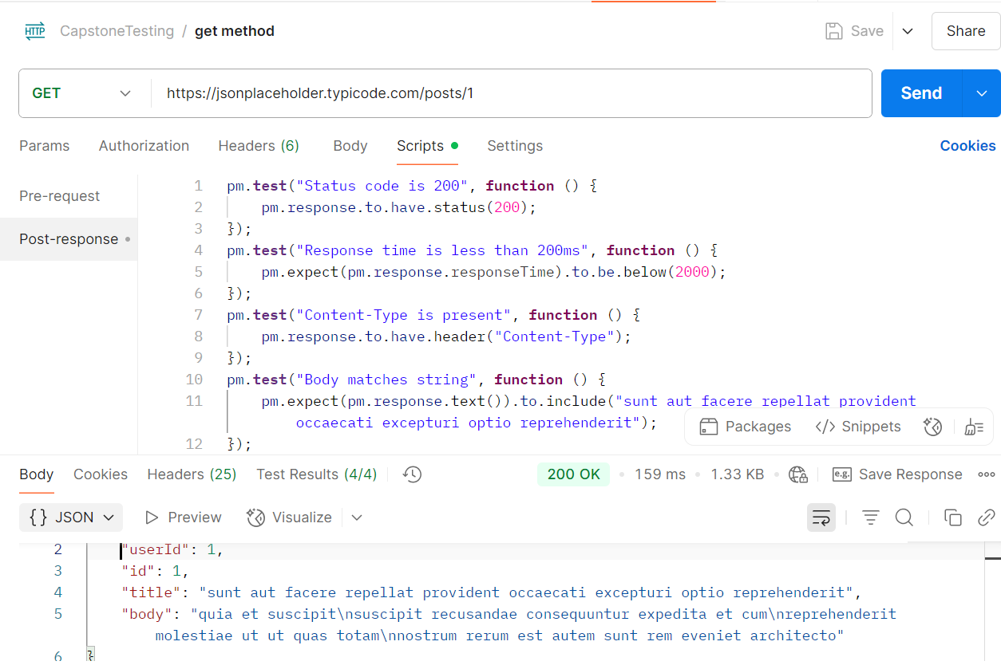
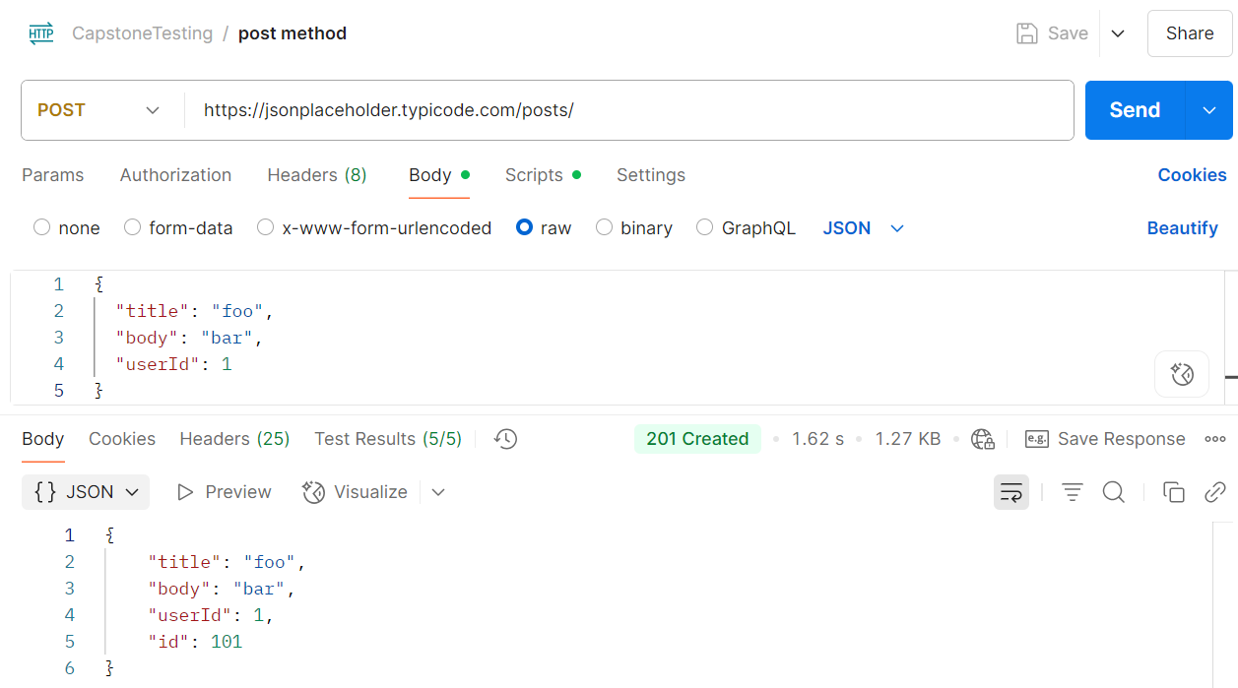
Get method and Post method

Slide 12
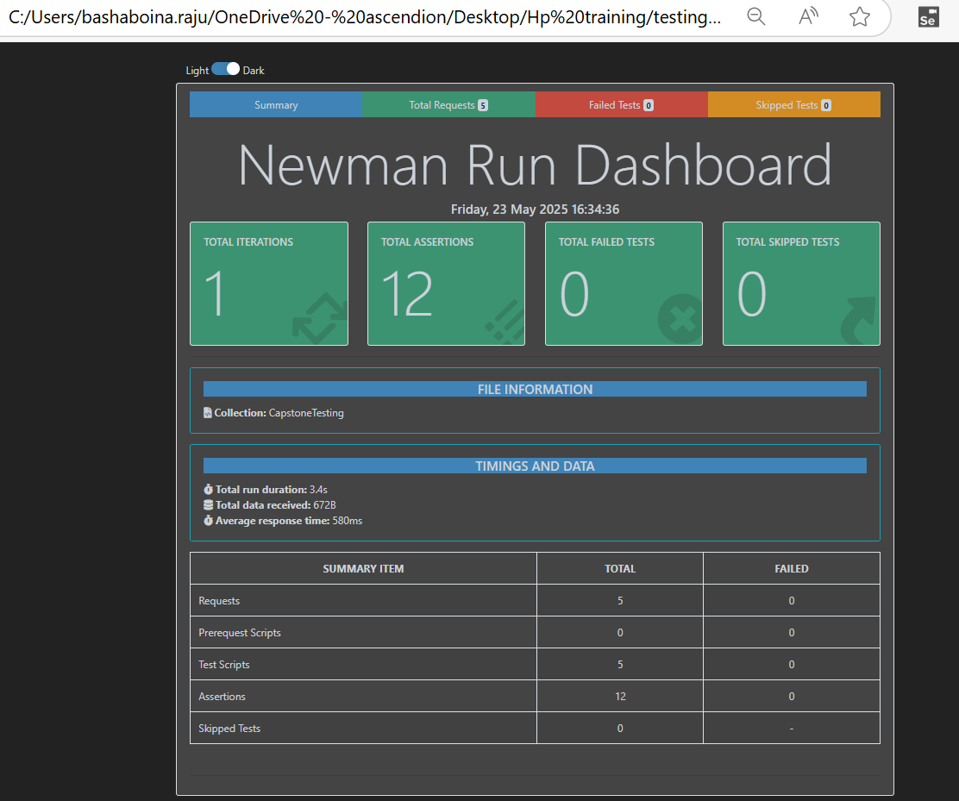
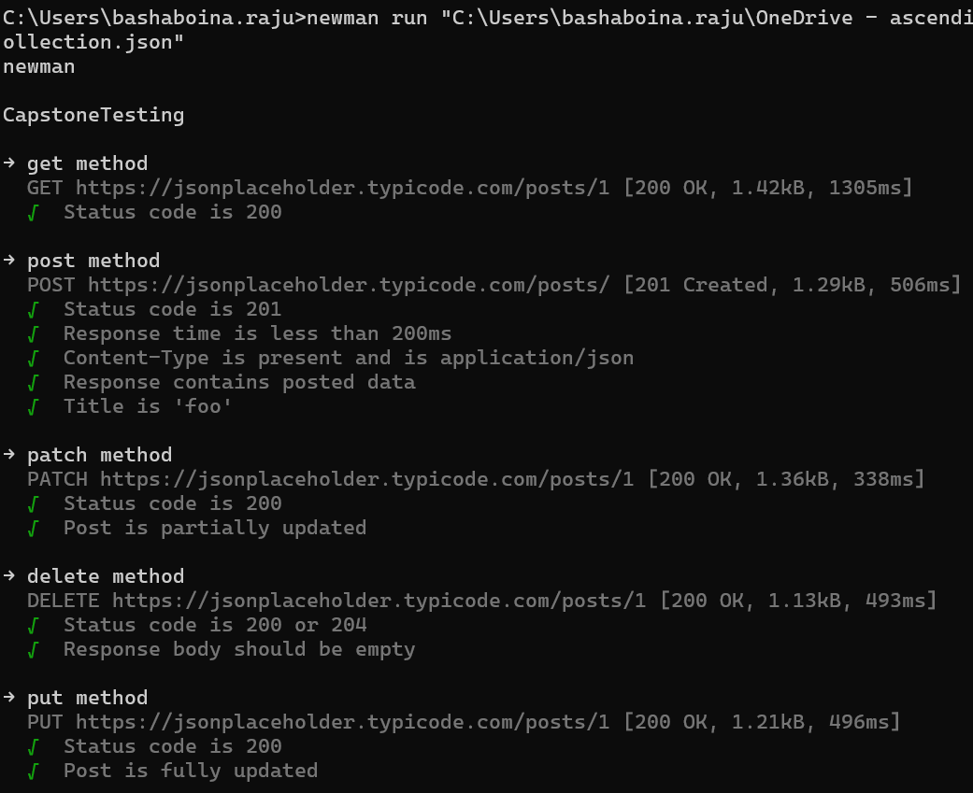
API Testing results and HTML Report

Slide 13
Performance Testing with JMeter
1) Tested 5 API endpoints of Application Url: https://jsonplaceholder.typicode.com/posts/
2) Captured performance metrics and generated HTML reports

Slide 14
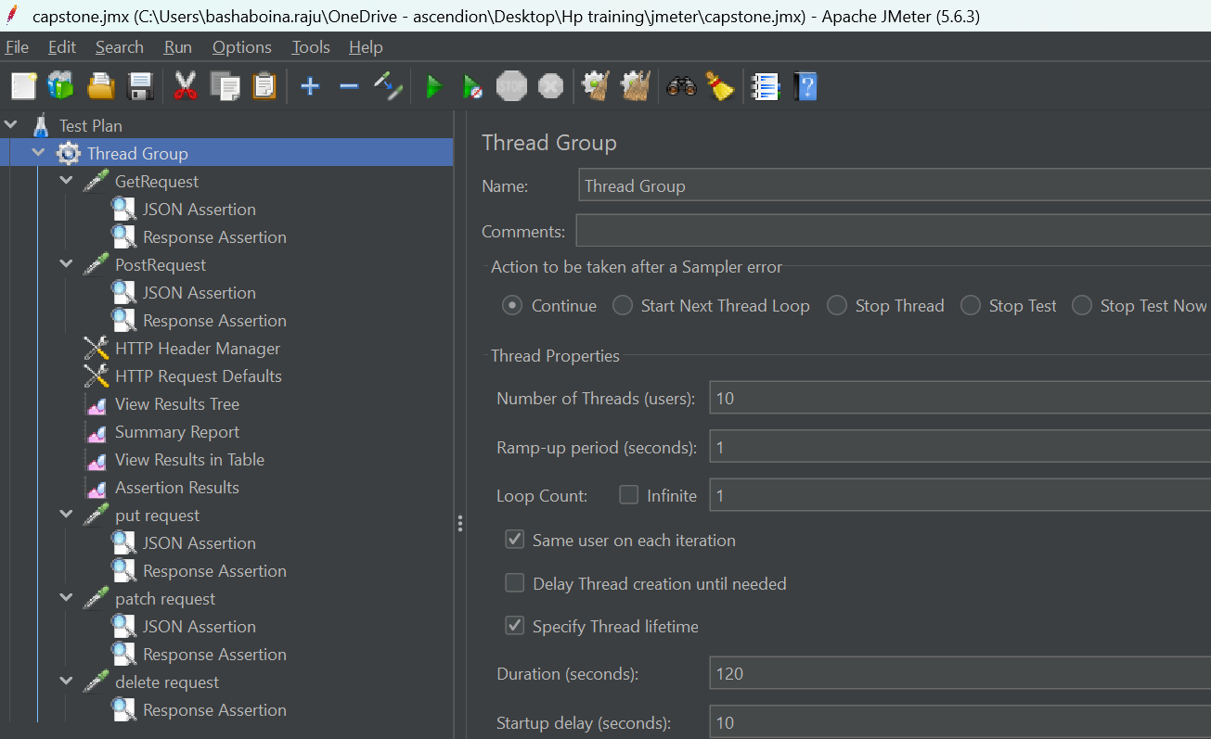
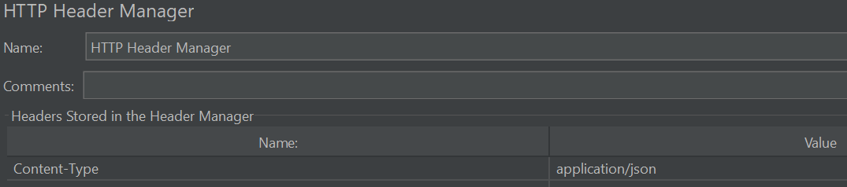
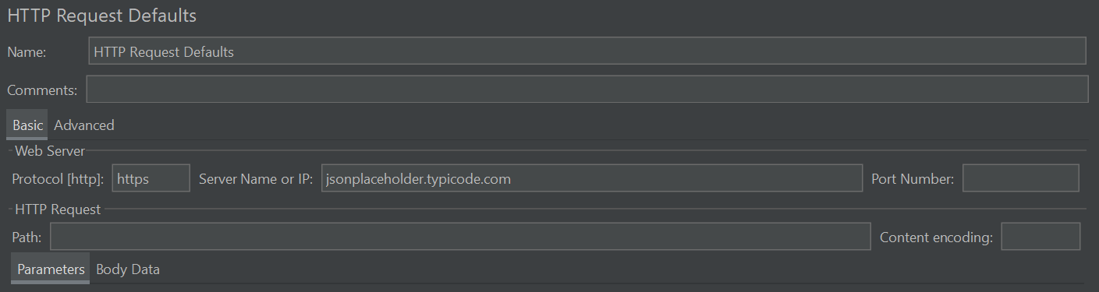
Thread Group , HTTP Header Manager and HTTP Request Defaults

Slide 15
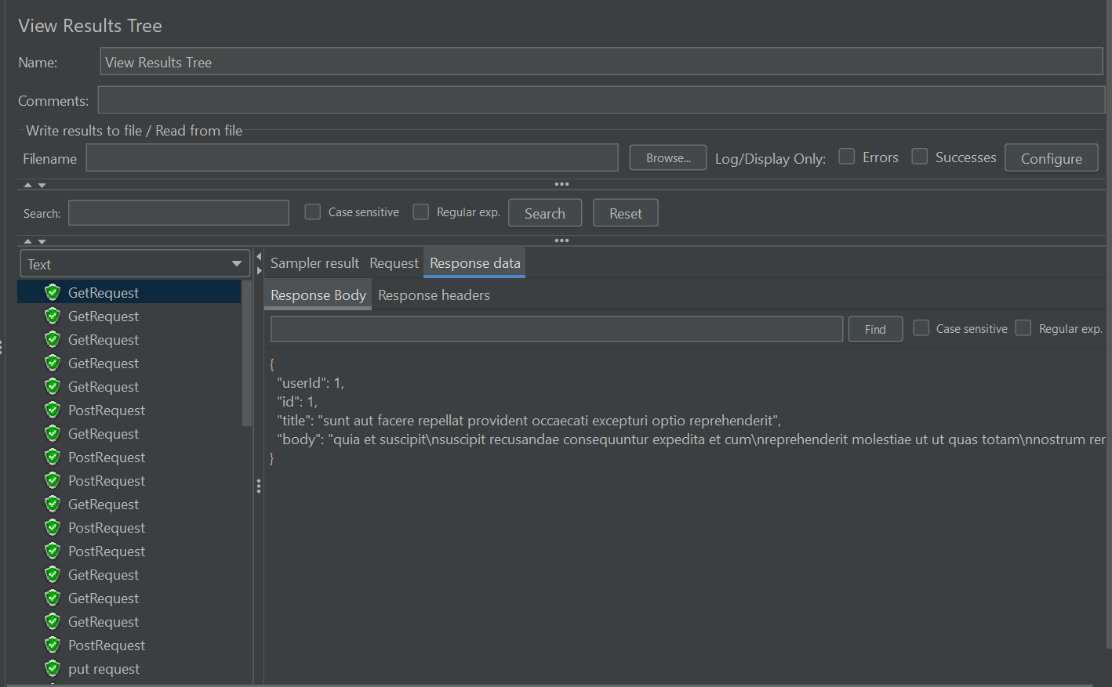
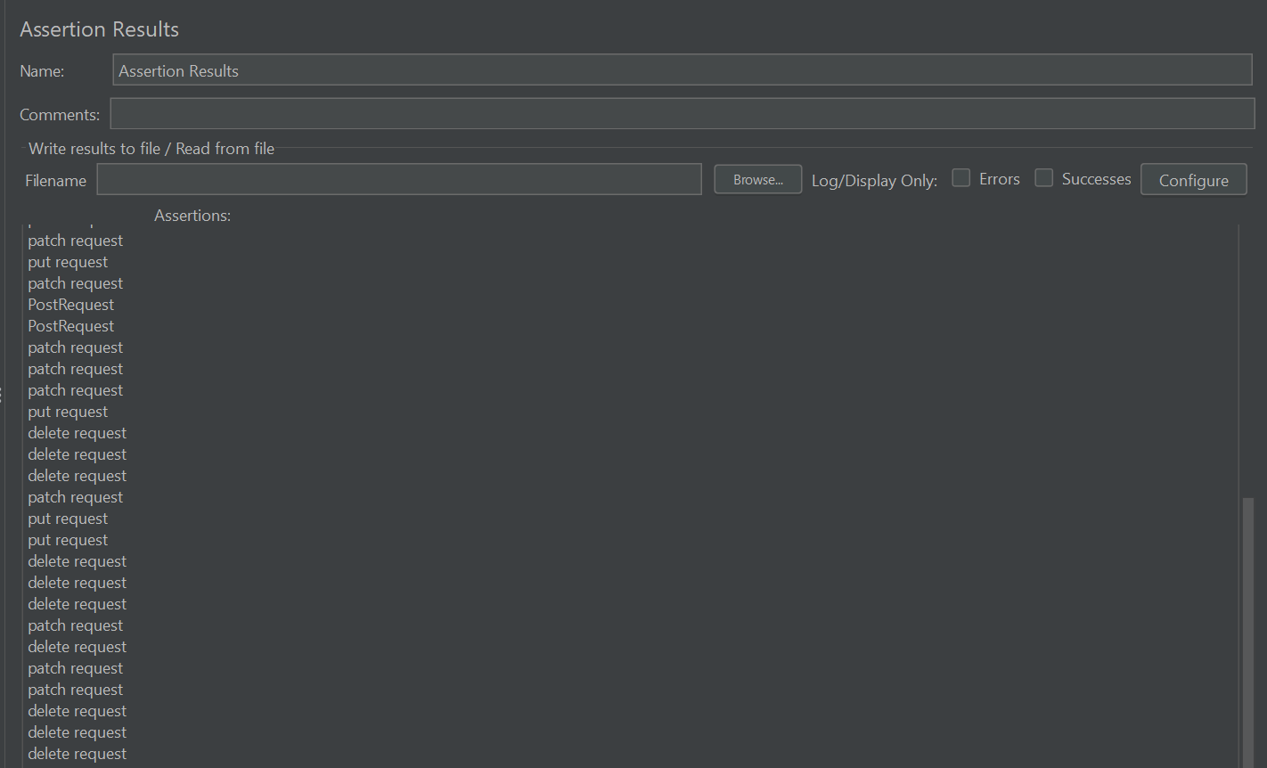
View Results Tree and Assertion Results

Slide 16
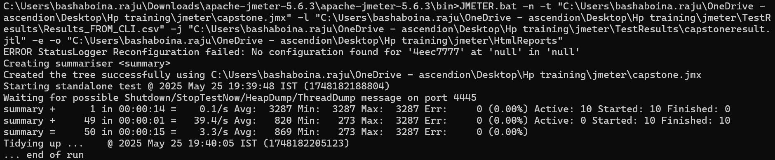
CLI command to run jmx file and generate html reports and csv file

Slide 17
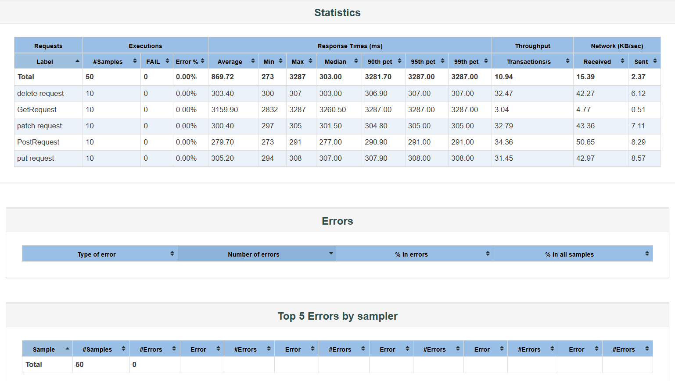
HTML Report

Slide 18
JIRA Integration & Test Management
Test Execution & Monitoring: Execute test cases directly within Jira and track their progress for effective test coverage and validation. Dashboard & Reporting: Configure custom dashboards to visualize real-time metrics such as sprint velocity, issue status, test execution summaries, and backlog health, enhancing visibility and project tracking.
Application Url: https://jsonplaceholder.typicode.com/posts/

Slide 19
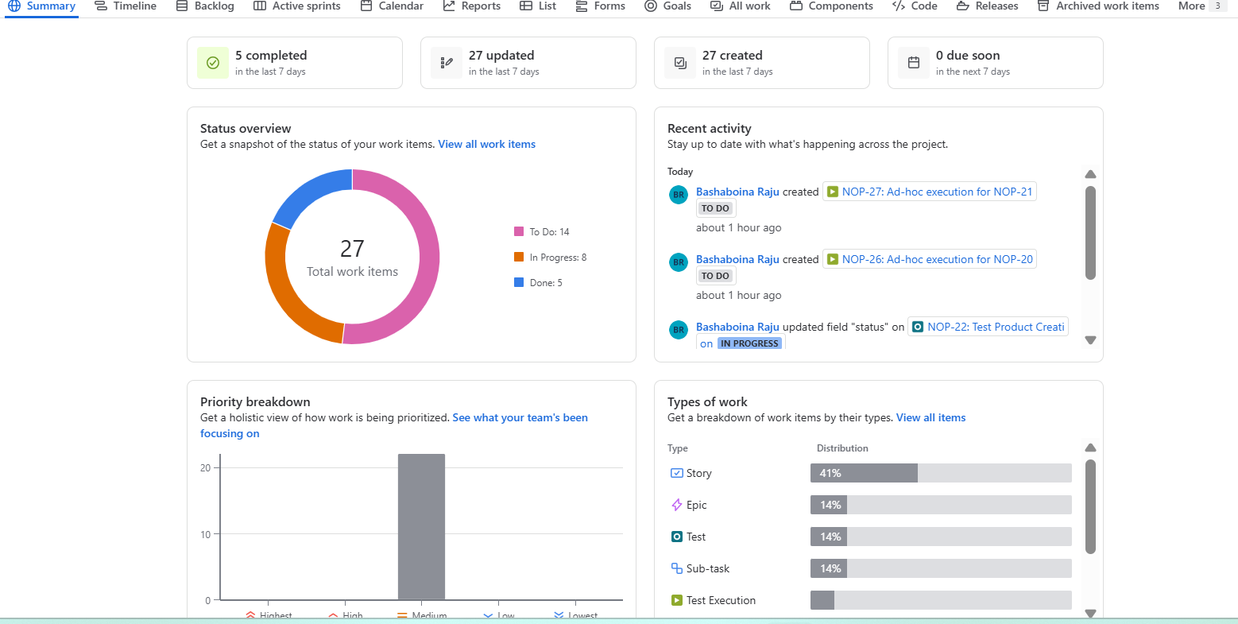
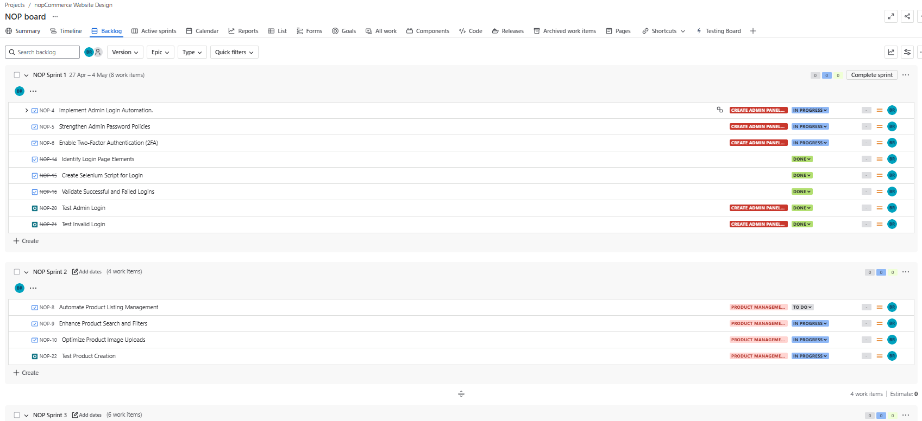
Jira Screenshots

Slide 20
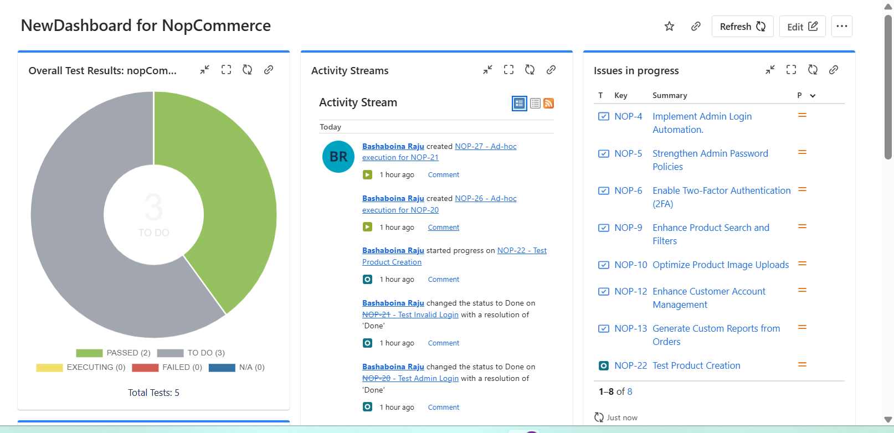
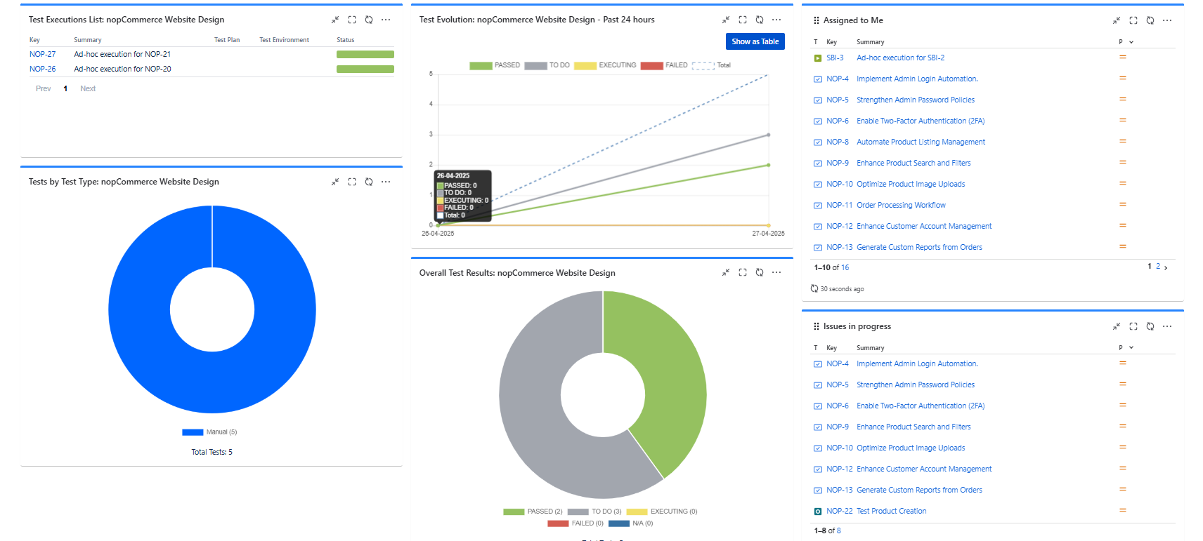
Dashboard

Slide 21
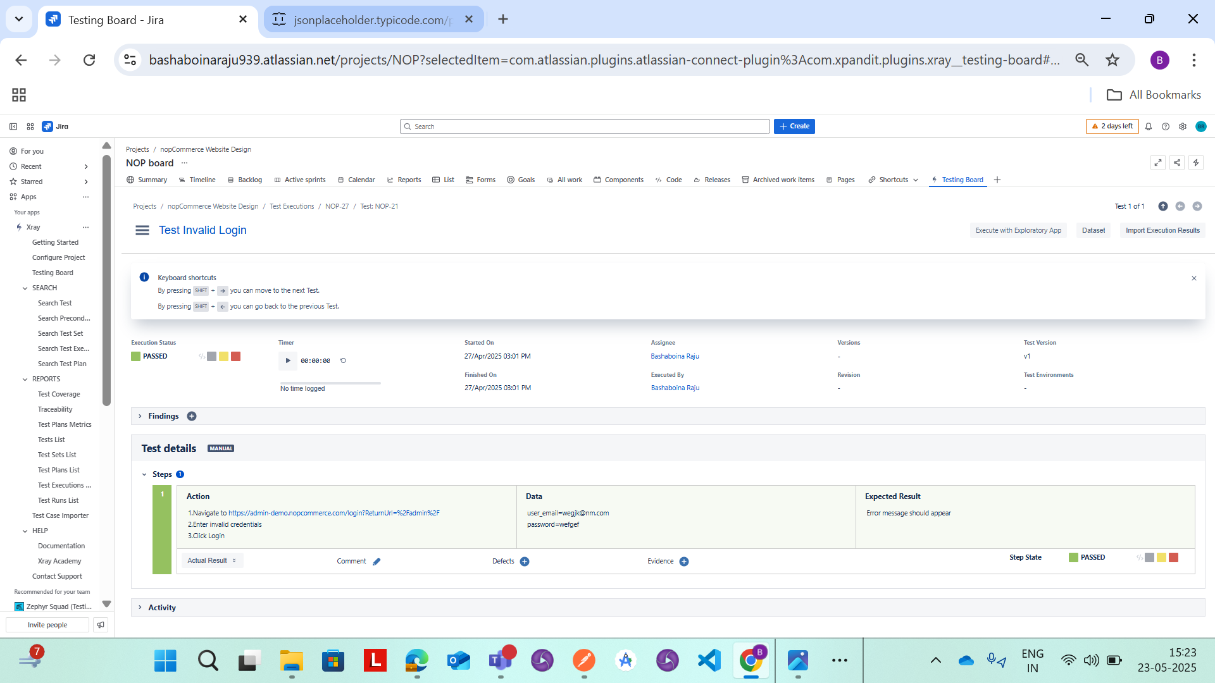
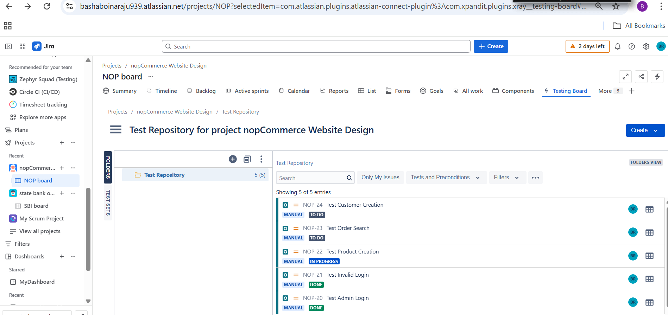
Testcases Results

Slide 22
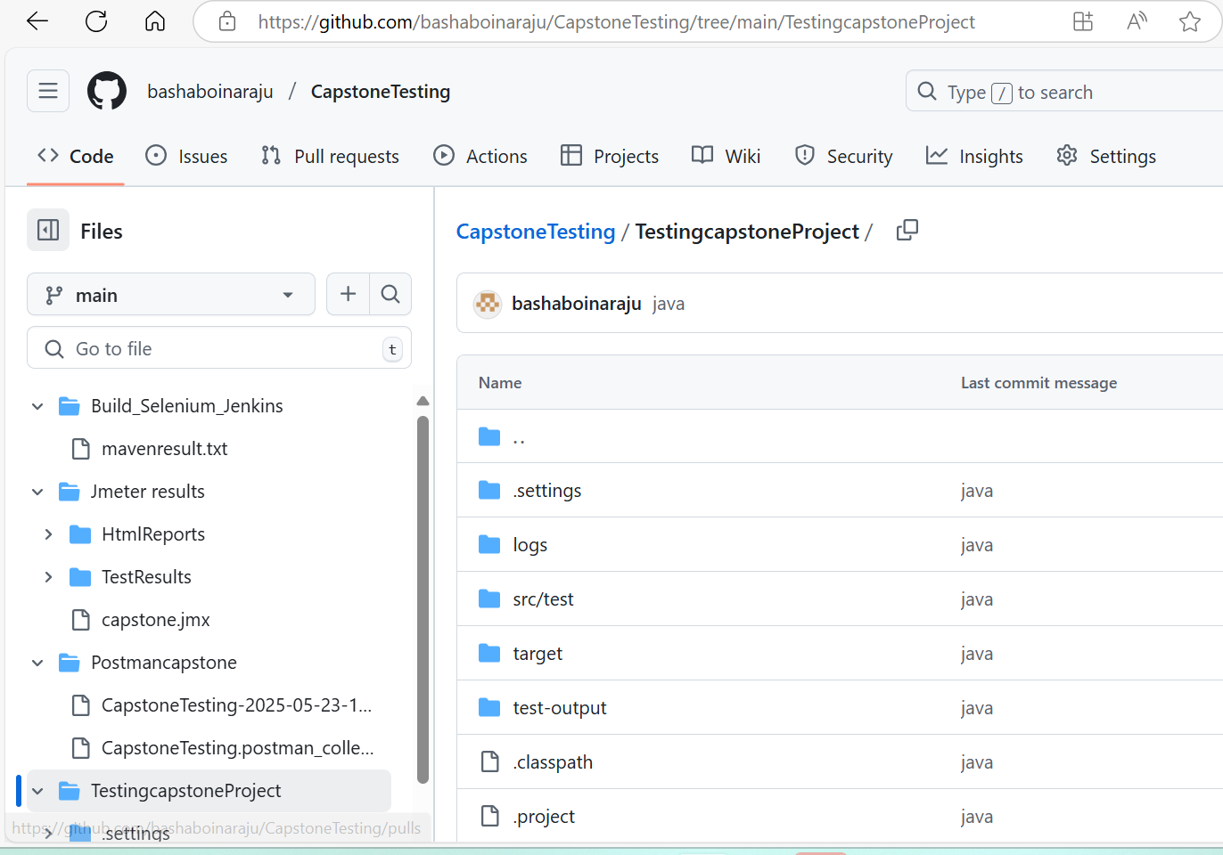
bashaboinaraju/CapstoneTesting
GITHUB URL:

Slide 23
Conclusion
This capstone project delivered a fully integrated end-to-end automation testing solution, incorporating Selenium for Web UI, Postman for API testing, and JMeter for performance validation.
Agile test management was implemented using Jira with Xray for real-time planning, execution, and tracking. The project followed CI/CD best practices with GitHub for version control and collaborative development. It achieved comprehensive test coverage, validated application stability and scalability, and reflected real-world QA practices.
This hands-on experience offered deep insights into automation frameworks, performance testing, agile methodologies, and industry-standard workflows.

Slide 24
Thank You

